Slide 1


TACTICAL COMBAT CASUALTY CARE COURSE
MODULE 23: Documentation
Module 23: Documentation
TCCC TIER 1
All Service Members
TCCC TIER 2
Combat Lifesaver
TCCC TIER 3
Combat Medic/Corpsman
TCCC TIER 4
Combat Paramedic/Provider

Slide 2




Module 23: Documentation
TACTICAL COMBAT CASUALTY CARE (TCCC) ROLE-BASED TRAINING SPECTRUM
ROLE 1 CARE
NONMEDICAL PERSONNEL
MEDICAL PERSONNEL
YOU ARE HERE
STANDARDIZED JOINT CURRICULUM
2

Slide 3









Module 23: Documentation
1 x TERMINAL LEARNING OBJECTIVES
26
Given a combat or noncombat scenario, perform documentation of care during Tactical Field Care in accordance with CoTCCC Guidelines.
26.1
Identify how to document casualty information on the DD Form 1380 TCCC Card and the proper placement of that card on the casualty, in accordance with DHA-PI 6040.01.
Demonstrate the proper documentation of care on a trauma casualty in Tactical Field Care.
Identify the importance and information considerations of a casualty After Action Report submission.
Demonstrate completion of an After Action Report.
26.2
26.3
26.4
4 x ENABLING LEARNING OBJECTIVES
#
= Terminal Learning Objectives
= Cognitive ELOs
= Performance ELOs
3

Slide 4
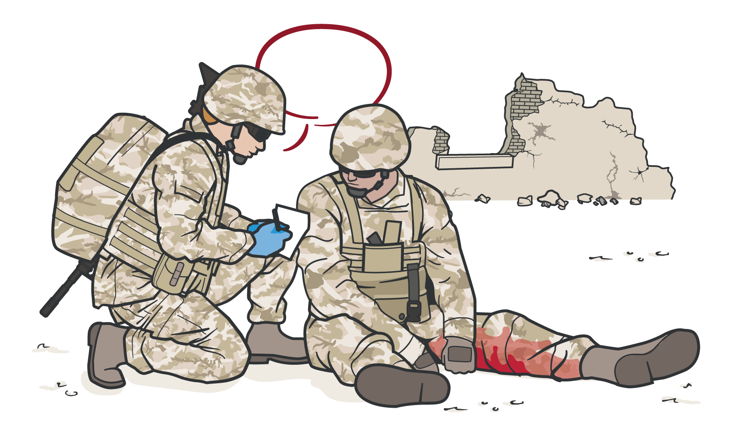
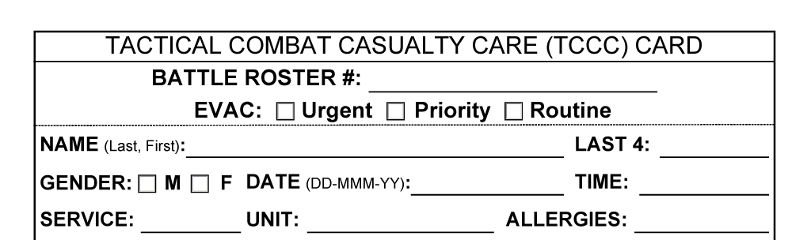

IMPORTANCE
OF DOCUMENTATION
Module 23: Documentation
Documentation directly impacts ongoing casualty care
Information is crucial to other providers in the continuum of care
Prehospital documentation becomes
a permanent part of the casualty’s longitudinal medical record
Data informs casualty care process improvement
REMEMBER Documentation of care on the battlefield is not simply an administrative requirement

Slide 5




Module 23: Documentation
CHALLENGES
IN DOCUMENTING CARE
TIME CONSTRAINTS
TASK SATURATION
(multiple casualties, etc.)
TACTICAL SITUATION
ENVIRONMENTAL CONSTRAINTS
(low light, weather, etc.)
REMEMBER You have not finished caring for a casualty until you have documented the care

Slide 6
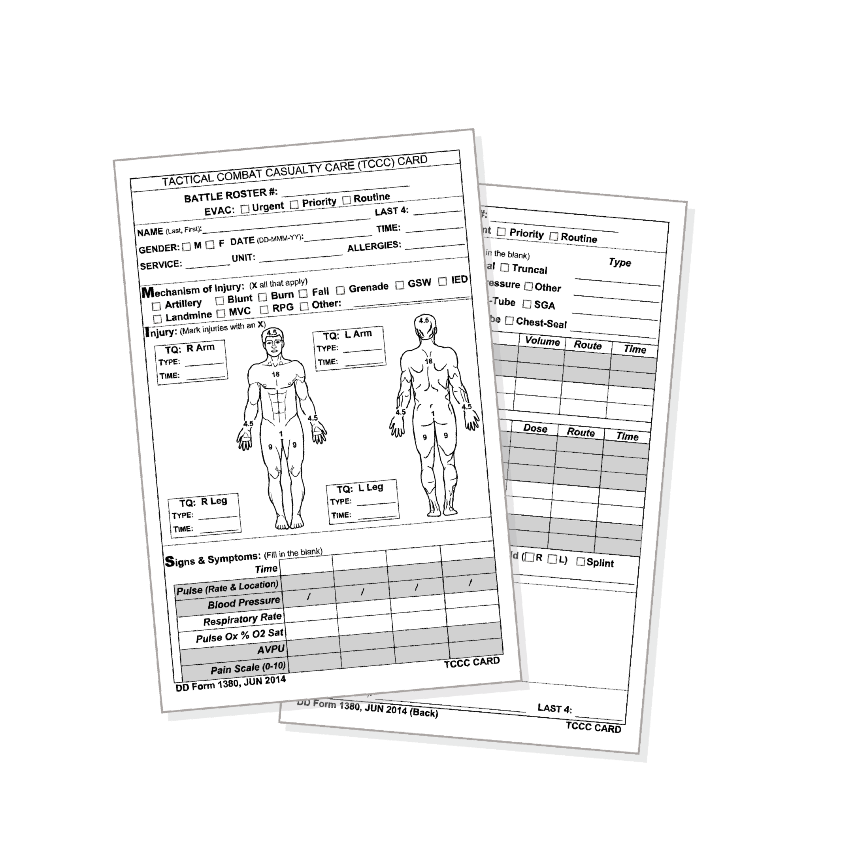
DD FORM 1380
TACTICAL COMBAT CASUALTY CARE (TCCC) CARD
Module 23: Documentation
ALL assessment and medical care (including interventions and medications) performed should be documented
Use the casualty’s TCCC Card, found in the Joint First Aid Kit, to document care
Completed by whoever is providing care at point of wounding and updated by all subsequent prehospital providers
Attached to the casualty and handed off during evacuation to next higher level of care

Slide 7



DD FORM 1380
Video can be found on deployedmedicine.com

Slide 8
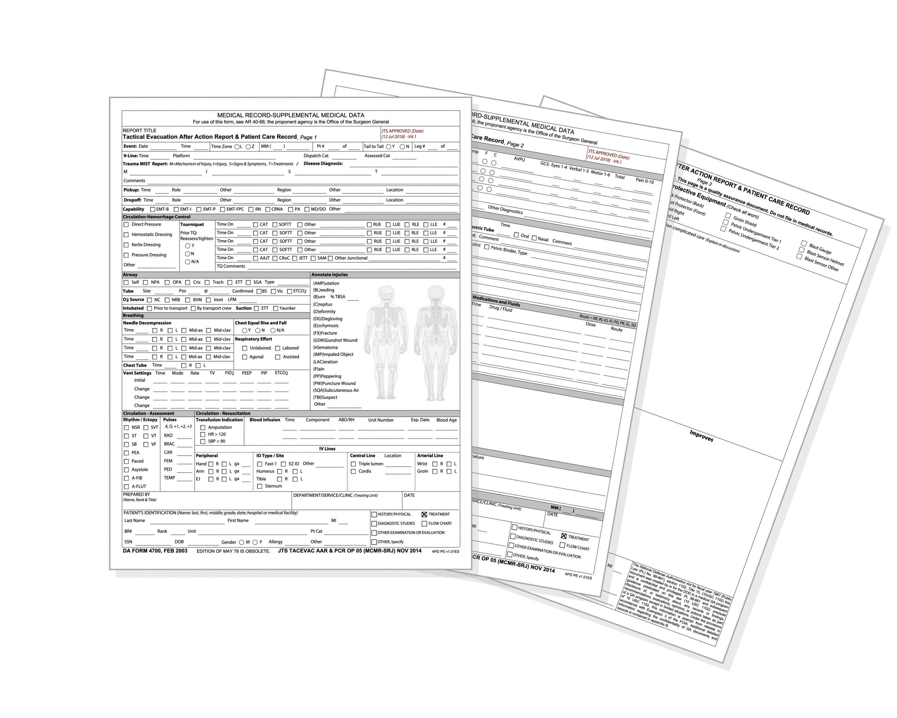
Module 23: Documentation
TACTICAL COMBAT CASUALTY CARE (TCCC) AFTER ACTION REPORT (AAR)
This electronic AAR is intended to be completed after the first responder completes the mission and returns to base
It is a more detailed and complete record of the care provided than the TCCC Card
Completed by unit Combat Medic/Corpsman and submitted electronically via the Joint Trauma System website within 72 hours
Both the TCCC Card and the TCCC AAR are required for optimal care documentation

Slide 9

SKILL STATION
Documentation (skills)
Module 23: Documentation
DD Form 1380 (TCCC Card)
TCCC After Action Report (AAR)

Slide 10

CHECK ON LEARNING
Module 23: Documentation
Why is it important to document prehospital combat casualty care?
What is the difference between the TCCC Card (DD Form 1380) and the TCCC After Action Report (AAR)?
TRUE or FALSE?
Only the Combat Medic/Corpsman can document prehospital care for a casualty using the TCCC Card (DD Form 1380)?

Slide 11



Module 23: Documentation
ANY QUESTIONS?

Slide 12
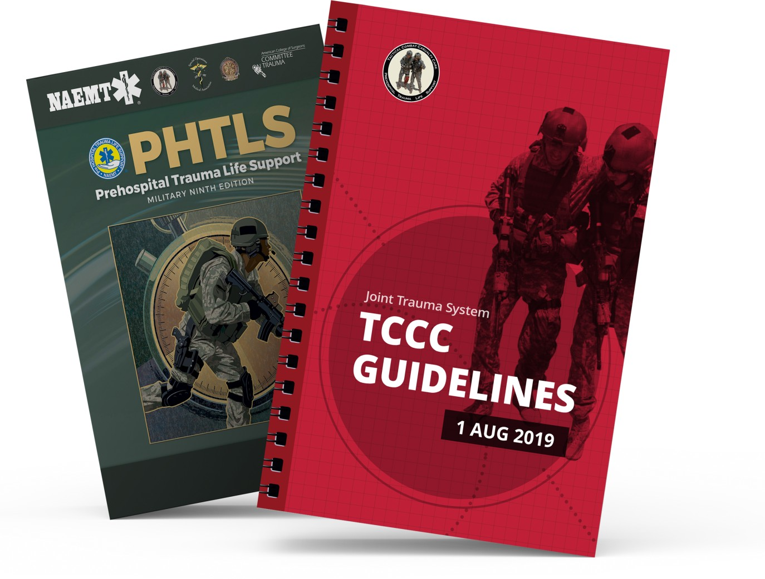
REFERENCES
Module 23: Documentation
TCCC: Guidelines
by JTS/CoTCCC
Updated regularly – latest edition dated 5 November 2020
These guidelines are the result of decisions made by the Committee on Tactical Combat Casualty Care as they explore evidence-based research regarding best practices
PHTLS: Military Edition, Chapter 25
by NAEMT
Prehospital Trauma Life Support, Military Ninth Edition
NOV 2020

